Slide 1







Simplex Method
The simplex algorithm operates on linear programs in the canonical form
maximize
subject to and
with the variables of the problem,
the coefficients of the objective function, A a p×n matrix
and nonnegative constants .
There is a straightforward process to convert any linear program into one in standard form, so using this form of linear programs results in no loss of generality.

Slide 2
Slack Variable: Variable added to a <= constraint to convert it to an equation (=).
A slack variable represents unused resources
A slack variable contributes nothing to the objective function value.
Surplus Variable: Variable subtracted from a >= constraint to convert it to an equation (=).
A surplus variable represents an excess above a constraint requirement level.
Surplus variables contribute nothing to the calculated value of the objective function.

Slide 3

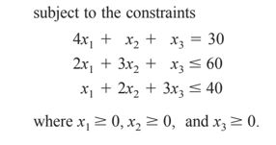
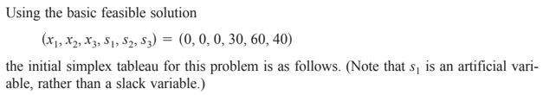
Example:-
Solution:-

Slide 4
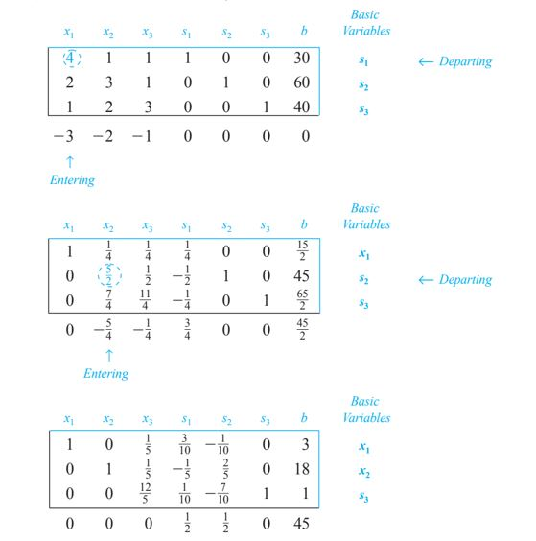
Contd:-

Slide 5
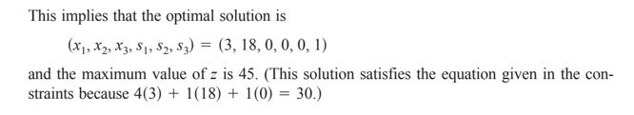
Contd:-

Slide 6
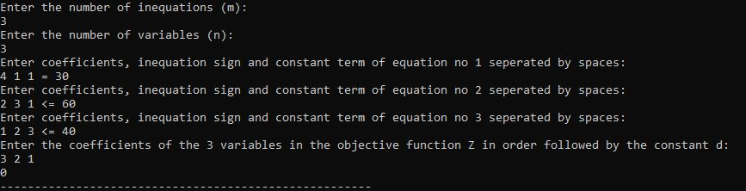
The code is written on the above algorithm as discussed in example section but the way input is given is different.
Input for the code is given in the following Format:-

Slide 7
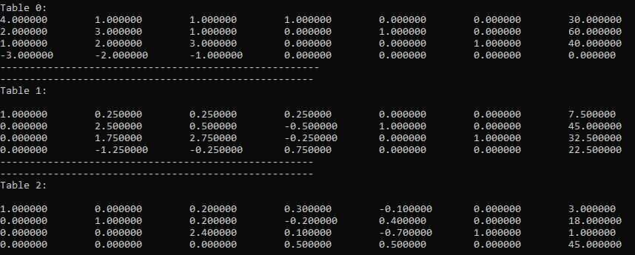
Solution:-

Slide 8
Optimum Solution:-
The Execution Time is :-

Slide 9
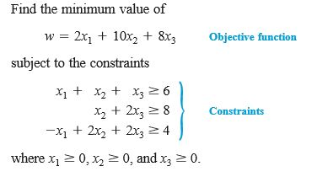
Simplex consists of both Minimization and Maximization problem,
In Minimization problem the initial table that will be created using objective function and inequality equation will be transposed to form a Maximization problem.
Example:-

Slide 10
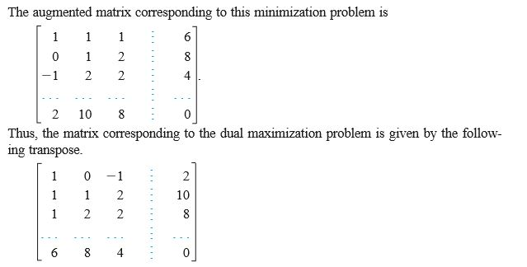
Solution:- Conversion of Minimization Problem to Maximization Problem using Transpose.
The second matrix is the transposed matrix and is converted to maximization problem now.

Slide 11
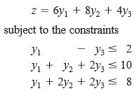
The problem is converted to maximization problem.
Now we need to solve the above as a maximization problem.

